Slide 1
Abnormalities Detection and Predictive Maintenance for Industrial Equipment
by
Abhijeet Panda

Slide 2
Objective
Develop a machine learning model to detect abnormalities in sensor data from equipment.
Predict when maintenance is required to prevent equipment failure.

Slide 3
Instruments used in the Project
Python & Scikit-Learn – For data preprocessing, model training, and evaluation.
XGBoost & Other ML Models – Used for machine failure prediction and classification of failure types.
SMOTE & Class Weighting – To handle imbalanced failure data and improve model learning.
Flask & Ngrok – For building and deploying the API, allowing remote access.
Joblib & Pickle – For saving and loading trained models and scalers efficiently.
Google Colab – For cloud-based model training, experimentation, and easy collaboration.

Slide 4
About the Dataset
The dataset consists of 10,000 records with the following features:
UID: Unique identifier ranging from 1 to 10,000.
Product ID: Consists of a letter L, M, or H, representing product quality:
L (50%) – Low quality
M (30%) – Medium quality
H (20%) – High quality
Followed by a variant-specific serial number.
Air Temperature [K]: Generated using a random walk process, normalized with a standard deviation of 2 K around 300 K.
Process Temperature [K]: Calculated as Air Temperature + 10 K, with a standard deviation of 1 K.
Rotational Speed [rpm]: Derived from a power of 2860 W, overlaid with normally distributed noise.
Torque [Nm]: Normally distributed around 40 Nm, with a standard deviation (σ) of 10 Nm (no negative values).
Tool Wear [min]:
H (High Quality) → +5 minutes
M (Medium Quality) → +3 minutes
L (Low Quality) → +2 minutes
Machine Failure (Target Variable):
Indicates whether the machine has failed at a given data point.
Failure can occur due to different failure types.
This dataset helps in detecting machine failures by analyzing sensor readings.

Slide 5
Understanding the variables
1. General Information
The dataset contains 10,000 rows and 10 columns.
There are no missing values or null values in any column.
There are no duplicate records in the dataset.
2. Unique Values
UID and Product ID have 10,000 unique values, meaning each row has a unique identifier.
Type has 3 unique values: ['M', 'L', 'H'], representing different product quality levels.
Target (Failure or Not) has 2 unique values: [0, 1], where 0 means no failure and 1 means failure.
Failure Type has 6 unique values:
'No Failure'
'Power Failure'
'Tool Wear Failure'
'Overstrain Failure'
'Random Failures'
'Heat Dissipation Failure'

Slide 6
Understanding the variables
3. Statistical Insights
Air Temperature [K]: Ranges from 295.3 K to 304.5 K with a mean of 300 K.
Process Temperature [K]: Ranges from 305.7 K to 313.8 K with a mean of 310 K.
Rotational Speed [rpm]: Varies between 1168 and 2886 rpm, with a mean of 1538 rpm.
Torque [Nm]: Ranges from 3.8 to 76.6 Nm, with a mean of 39.98 Nm.
Tool Wear [min]: Varies between 0 and 253 minutes, with a mean of 107.95 minutes.
4. Key Observations
The dataset is clean with no missing or duplicate values.
Most features are numerical, except for Type and Failure Type, which are categorical.
Failures occur in only a small portion of the data (Target mean is 0.0339, meaning ~3.4% of cases have failures).
Different failure types exist, making it important to classify failures properly.
This dataset is well-structured for machine failure detection and will be used to train a model for abnormality detection.

Slide 7
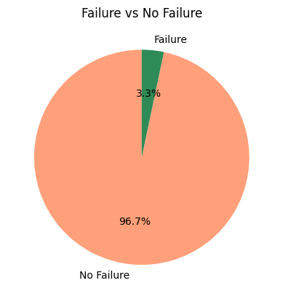
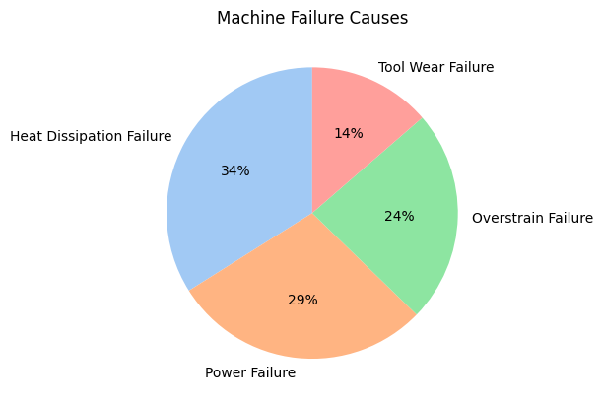
Basic Visualisation of Data

Slide 8
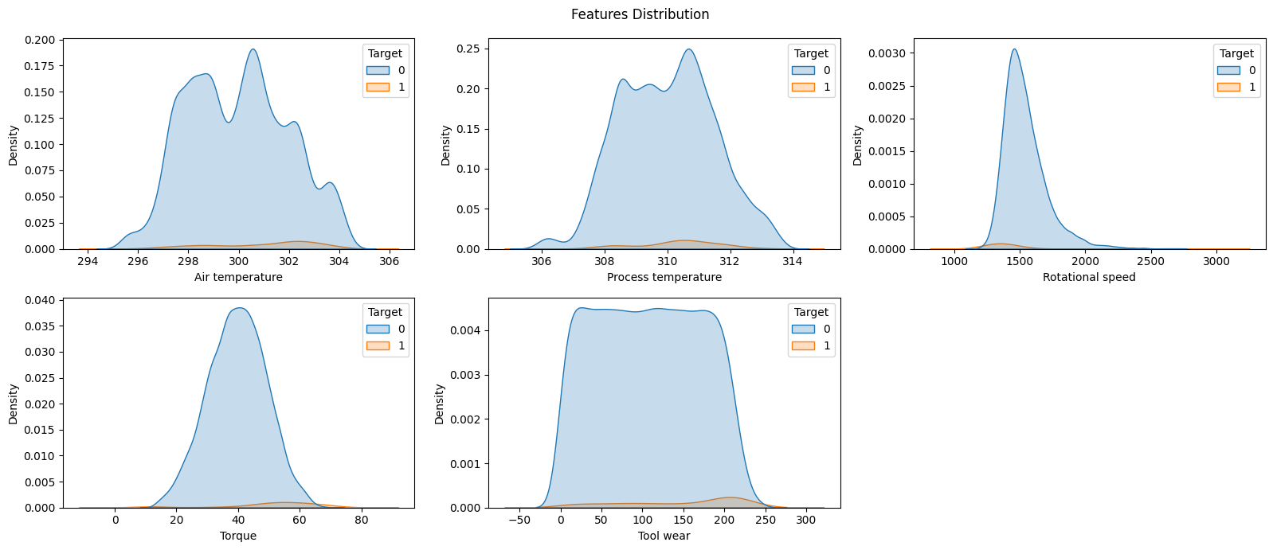
Basic Visualisation of Data

Slide 9
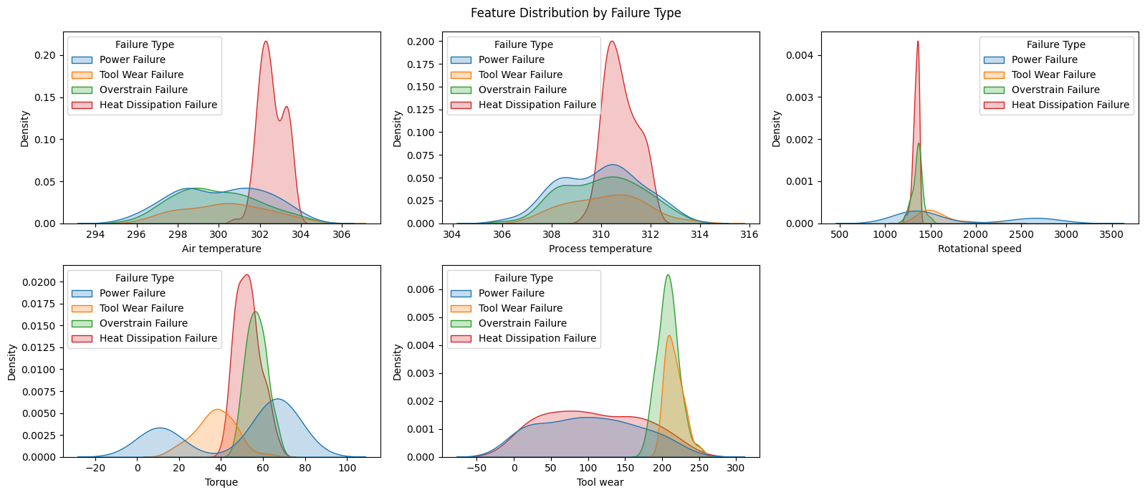
Basic Visualisation of Data

Slide 10
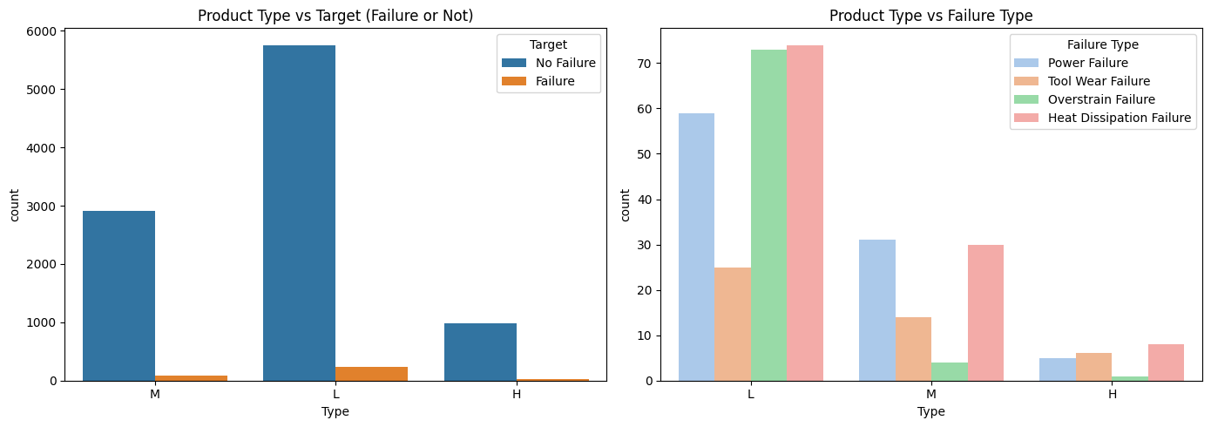
Basic Visualisation of Data

Slide 11
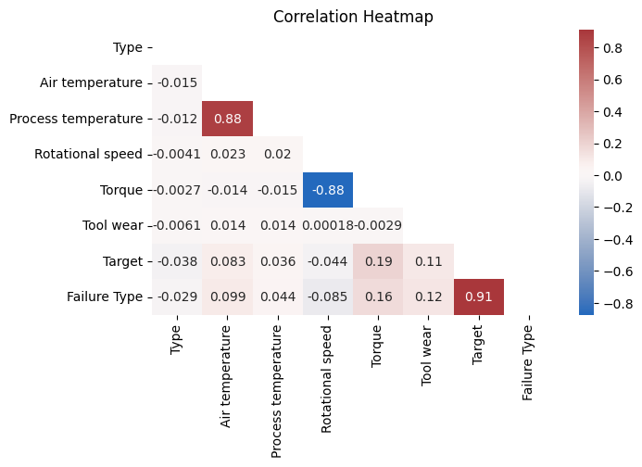
Correlation Heatmap

Slide 12
Data Wrangling
Outlier Treatment
Scaling the numerical data
And Encoding the categorical data
Handling the imbalance data by oversampling using SMOTE technique

Slide 13
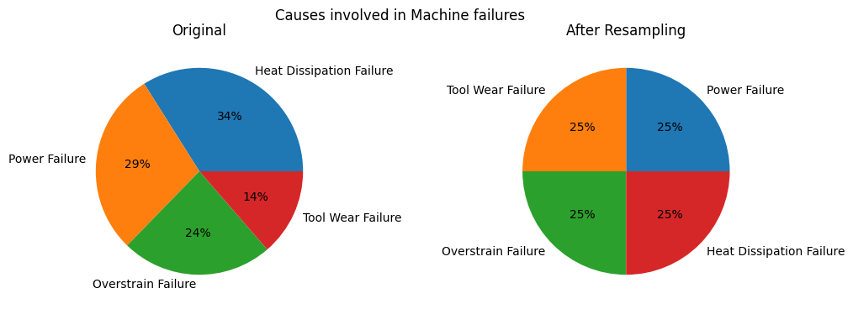
Handling the Imbalance Data

Slide 14
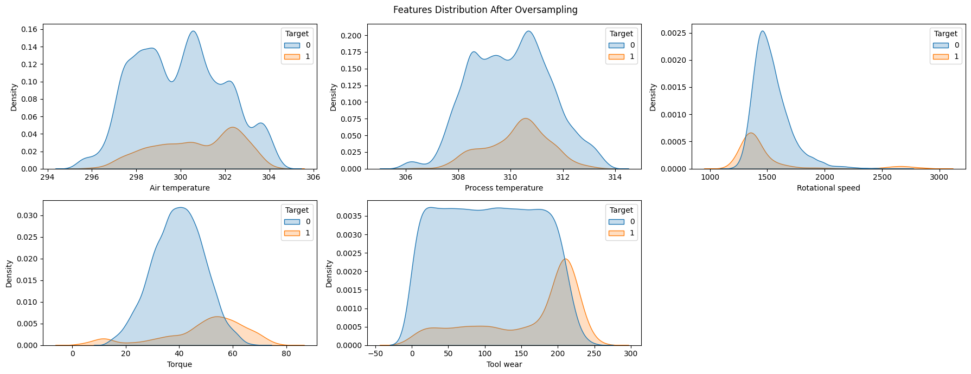
Handling the Imbalance Data

Slide 15
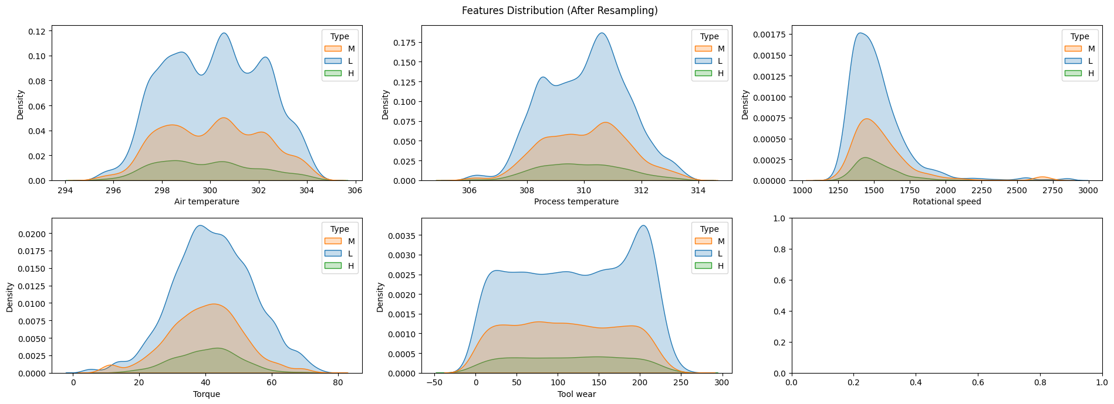
Handling the Imbalance Data

Slide 16
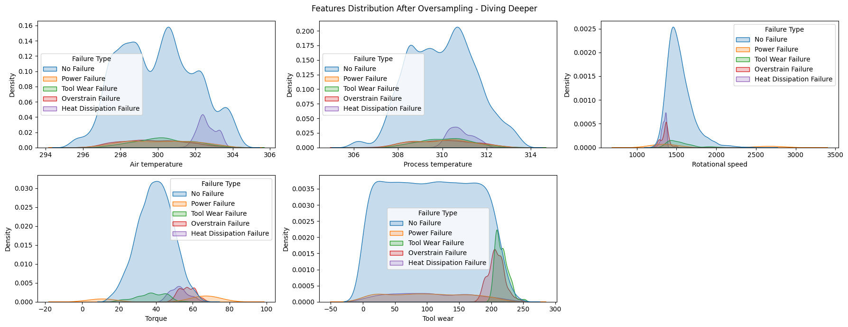
Handling the Imbalance Data

Slide 17
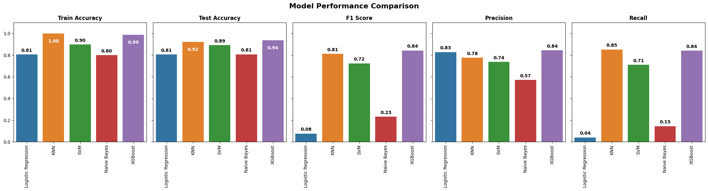
Model- 1 Failure or Not Failure

Slide 18
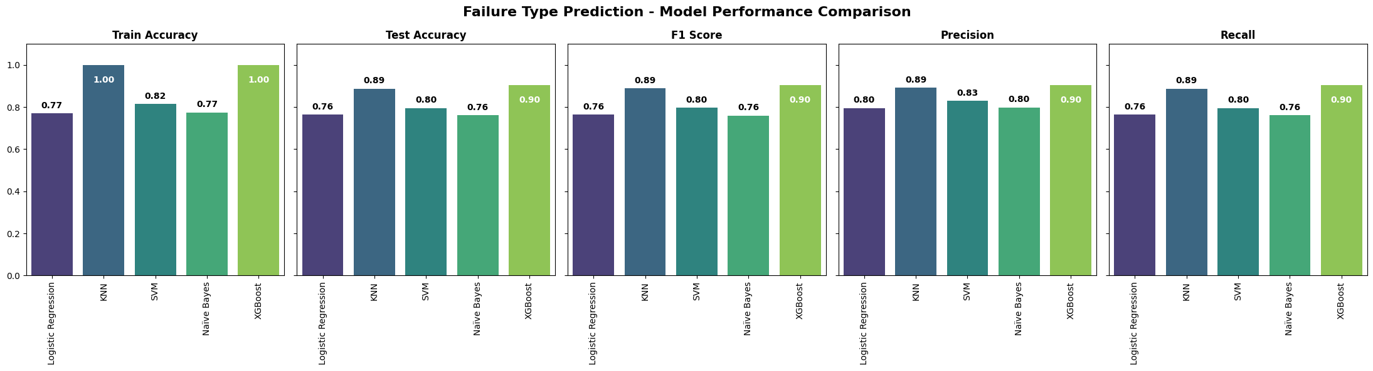
Model- 2 Detect Failure Type

Slide 19
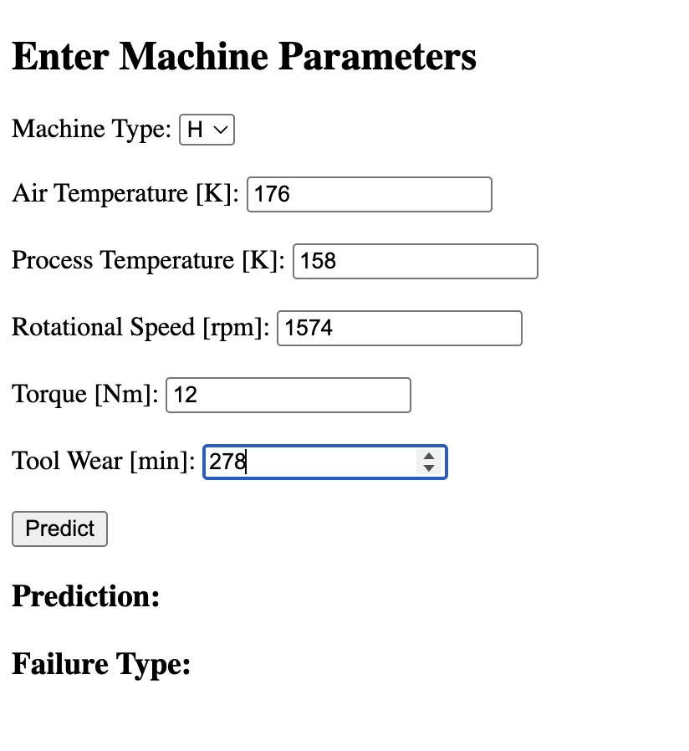
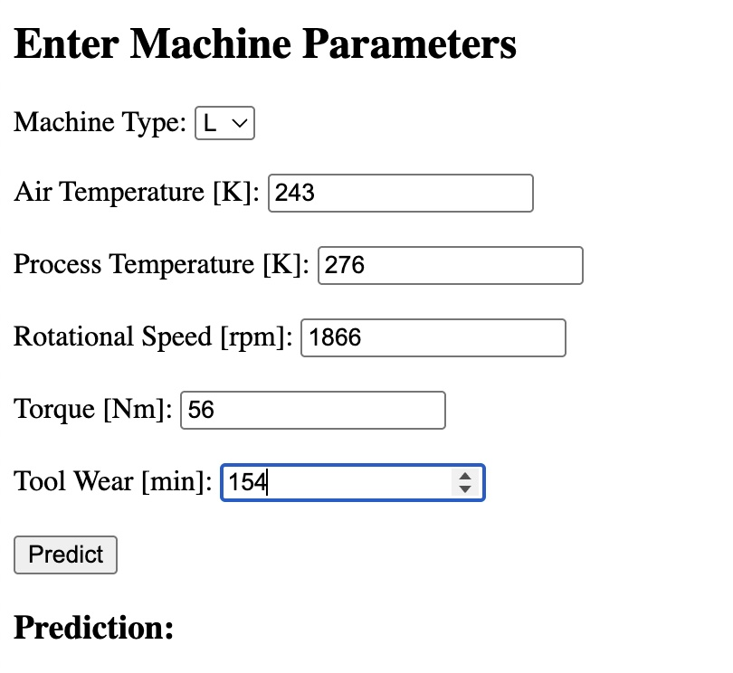
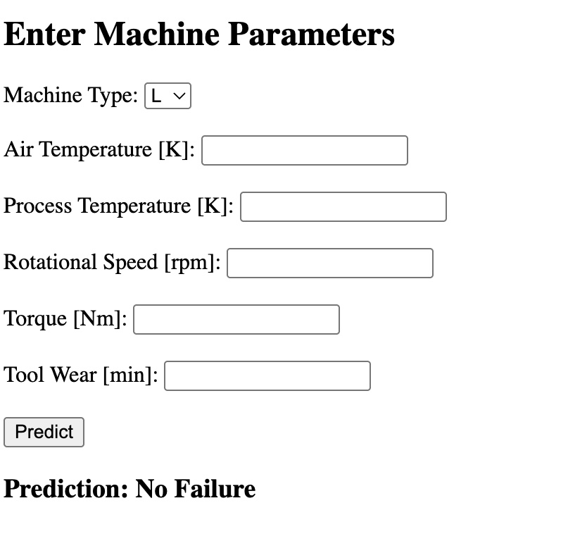
Model Deployment
Heat Dissipation Failure

Slide 20
Key Challenges
Imbalanced Data Handling – Failure cases were significantly fewer than non-failure cases, requiring techniques like SMOTE or class weighting to improve model performance.
Feature Scaling Issue – The 'Type' column (categorical) was mistakenly scaled, leading to errors in model input shape, which needed careful preprocessing adjustments.
Model Selection & Optimization – Finding the best-performing model among Logistic Regression, KNN, SVM, Naïve Bayes, and XGBoost required extensive hyperparameter tuning.
Deployment with Flask & Ngrok – Setting up a web interface and ensuring proper API responses while managing Ngrok tunnel connectivity issues.
Real-Time Prediction Performance – Ensuring that predictions were fast and accurate, while handling unexpected input errors gracefully.

Slide 21
Conclusion
This project develops a Machine Failure Prediction System using XGBoost models, handling imbalanced data with techniques like SMOTE or class weighting for better accuracy. It preprocesses data with feature scaling (excluding categorical) to ensure consistency. The system is deployed via Flask and Ngrok, enabling remote access. It provides real-time failure detection and classification based on machine parameters. This solution enhances predictive maintenance, reducing downtime and improving industrial efficiency.

